Slide 1
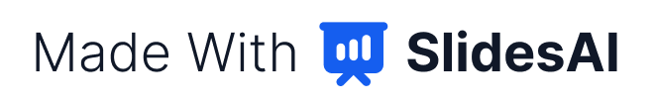
ActionShield AI: A Safety Checkpoint for AI Agents
Team QuantumMinds presents ActionShield AI, a pre-execution safety layer for AI agents.
ActionShield acts as a checkpoint between an AI agent and the tools it uses. Before any proposed action runs, it checks the user's original intent, permissions, and risks.
Our thesis: an agent should earn the right to act, not assume it.

Slide 2
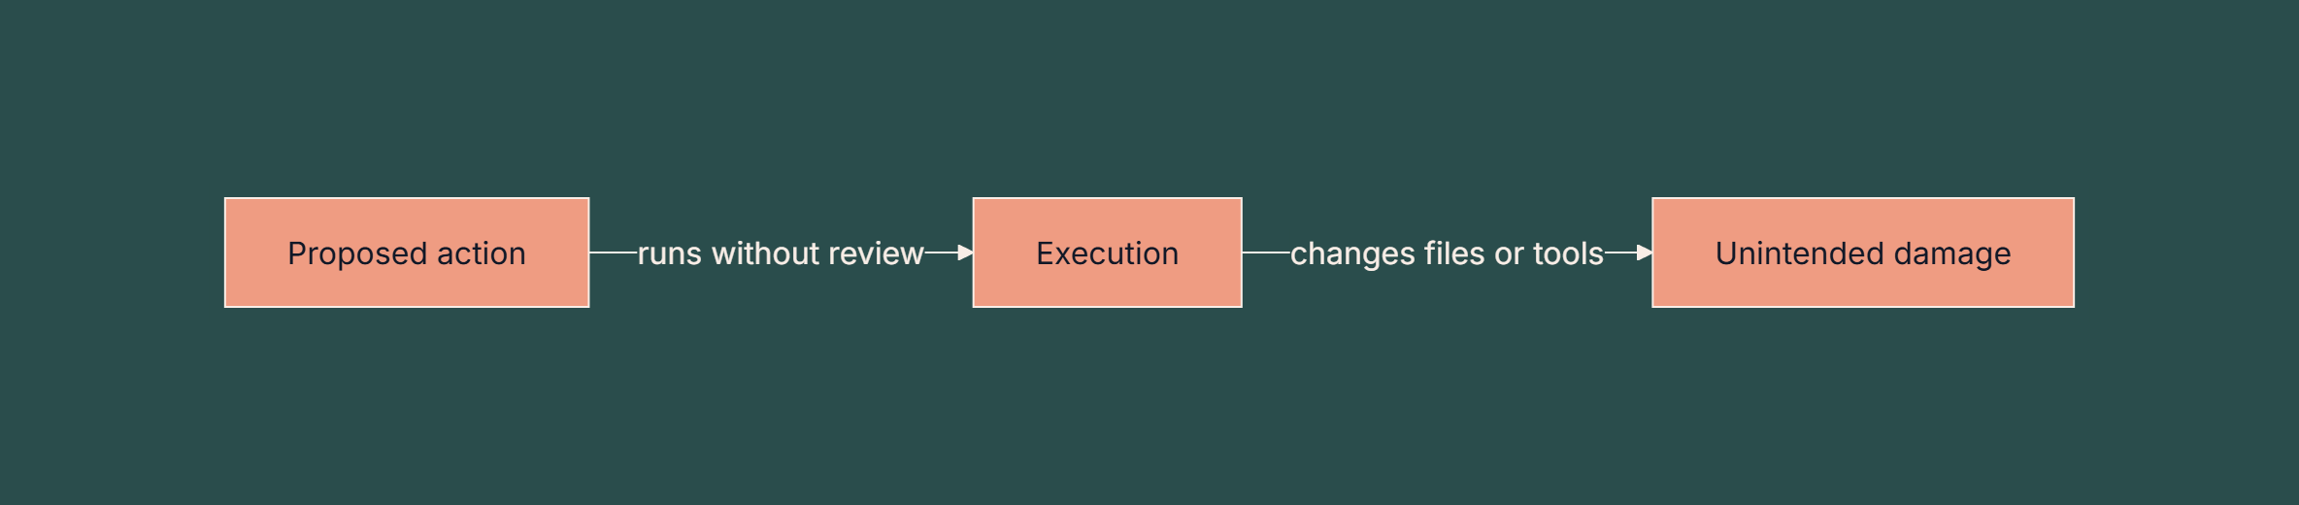
Why Agents Need a Check Before They Act
Agents can execute file and tool actions before anyone reviews intent or risk. A single misread instruction can turn into a real change on disk.
The causal chain behind the stakes:
Without a check, the agent's plan is the only safeguard between intent and effect. Ask the room: how many of you have seen an automation do more than it was asked?

Slide 3
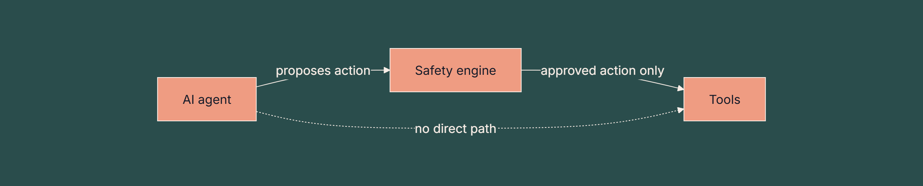
Our Idea: A Gate Between the Agent and Its Tools
ActionShield sits between the planner and the tools, so every proposed action is checked first.
The safety engine is the only route to execution.
Each action is judged against intent, permissions, and risk before it runs.
Blocked actions never reach the tools.

Slide 4



Three Outcomes: ALLOW, REVIEW, BLOCK
Each proposed action receives exactly one of three decisions.
ALLOW
REVIEW
BLOCK
The action is safe and authorized, and it runs.
The action is sensitive or uncertain, and a human must approve it.
The action is unsafe or violates policy, and it does not run.
Walk the judges through one example of each decision.

Slide 5
Five-Layer System Architecture
The system is organised as five layers, each with one job.
1
2
3
4
5
User interface
AI action planning
Safety and policy enforcement
Controlled sandbox execution
Audit logging
Safety and policy enforcement decides before anything executes.
Controlled sandbox execution runs only simulated file operations.
Audit logging records every decision for review.

Slide 6




Four Policy Checks Inside the Safety Engine
The engine runs four rule-based checks on each action:
Permission validation
Intent validation
is the action allowed for this user and resource?
does the action match the user's original request?
Risk classification
Duplicate-action detection
how dangerous is the action, such as deletion?
has this exact action already been proposed?
An LLM API supports the analysis, with rule-based fallback as a deliberate design choice, so the checks still run when the model is unavailable.

Slide 7
Planned Technology Stack and Build Approach
This is the planned stack, not a finished build.
Area | Planned choice | Role
Backend and safety logic | Python | Policy rules and decision engine
Dashboard | Streamlit | Audit and action view
History and audit logs | SQLite | Action history and audit records
API layer | FastAPI | Optional service layer
Development | VS Code, Git, GitHub | Editing, version control, and sharing
The approach keeps the safety logic in plain Python, so every rule can be read and tested directly.

Slide 8

Live Demo: Organizing a Folder Without Deletion
The demo runs the request "Organize my project folder, but do not delete any files" through five steps: proposed actions, safety review, decisions, sandbox run, and audit view.
Side-by-side comparison of the simulated workflow:
Stage | Without ActionShield | With ActionShield
Create folders | Runs directly | ALLOW, runs
Rename files | Runs directly | REVIEW, waits for approval
Delete duplicates | Runs directly | BLOCK, does not run
Record of actions | Not captured | Logged in the audit view
Close the demo by opening the audit dashboard.

Slide 9



Planned Evaluation Metrics
These four measures define how success will be judged. No results are claimed here.
Simulated test cases
Unsafe-action block rate
Coverage of safe, sensitive, and unsafe actions
Share of unsafe actions the engine stops
False positives
Added processing time
Safe actions wrongly blocked or sent for review
Latency the safety check adds to each action

Slide 10
Impact, Limitations, and Next Steps
Impact: a safety checkpoint lets agents act on routine work while people stay in control of sensitive and irreversible steps.
Limitations: this is a student prototype, and the sandbox is simulated. Real-world coverage is not yet tested.
Next steps: build the planned stack, run the simulated test cases, and report the four measures honestly.
Thank you. I welcome your questions.

